Slide 1
Linux Basic Command

Slide 2
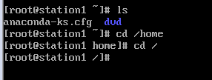
File structure
file structure
/ --root file = similar to C: in windows
$ = ordnary user
and # = root

Slide 3
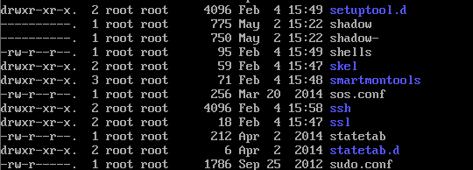
~ home directory
~ home directory
owner g.owner kb
-d = directory root root 766 date file/ directory name
- = file
l = link
up and down arrow keys for go back to previous transactions

Slide 4
up and down arrow keys for for go back to previous transactions

Slide 5
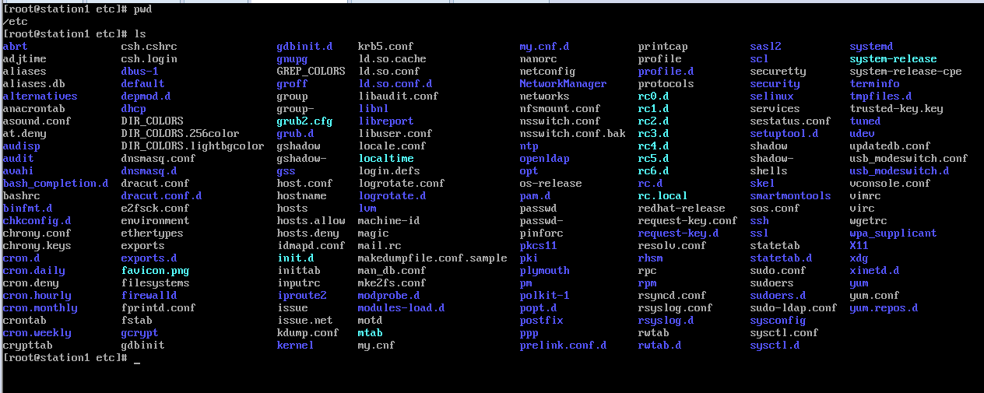
Pwd ,ls
Pwd :path
ls

Slide 6
ll
It provides very details of information and might exceed the current page

Slide 7
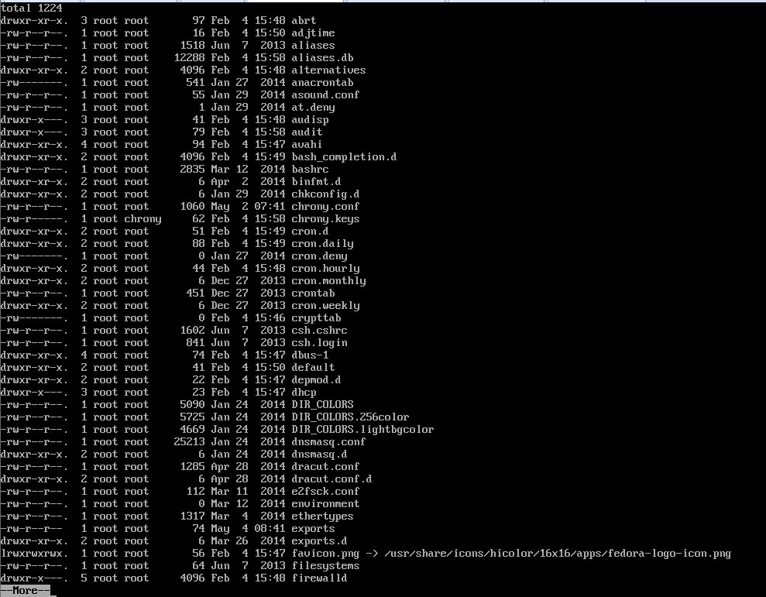
ls -l | more
ls -l | more = pagewise , enter = for line by line, spacebar = for page and ctl+C = terminate , Q = to exit from command

Slide 8
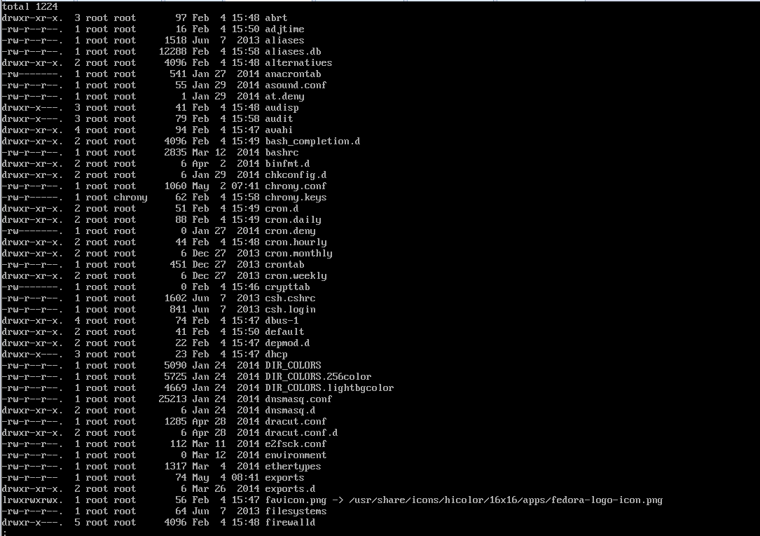
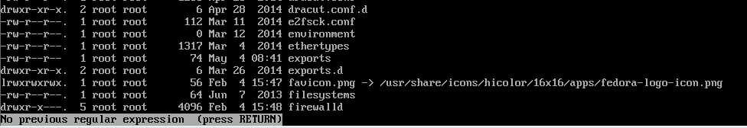
Ls –l | less
Shows the last page

Slide 9
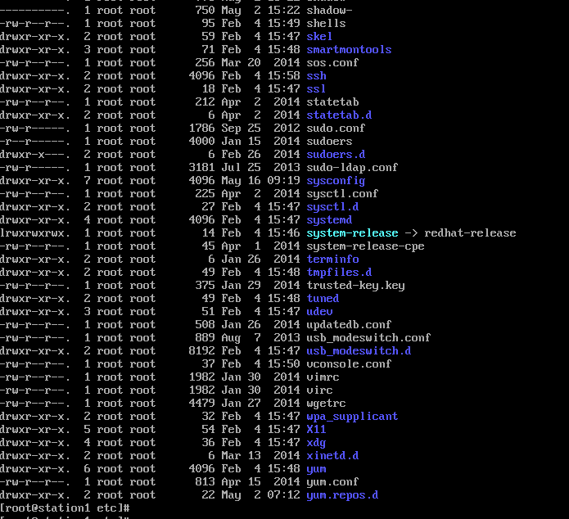
Ls -la
ls -la = show you hidden files

Slide 10

ls -l | wc -l
ls -l | wc -l count lines

Slide 11
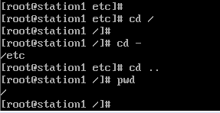
cd
cd /
cd -
cd ..

Slide 12
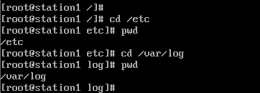
absolute path
cd /etc
cd /var/log

Slide 13
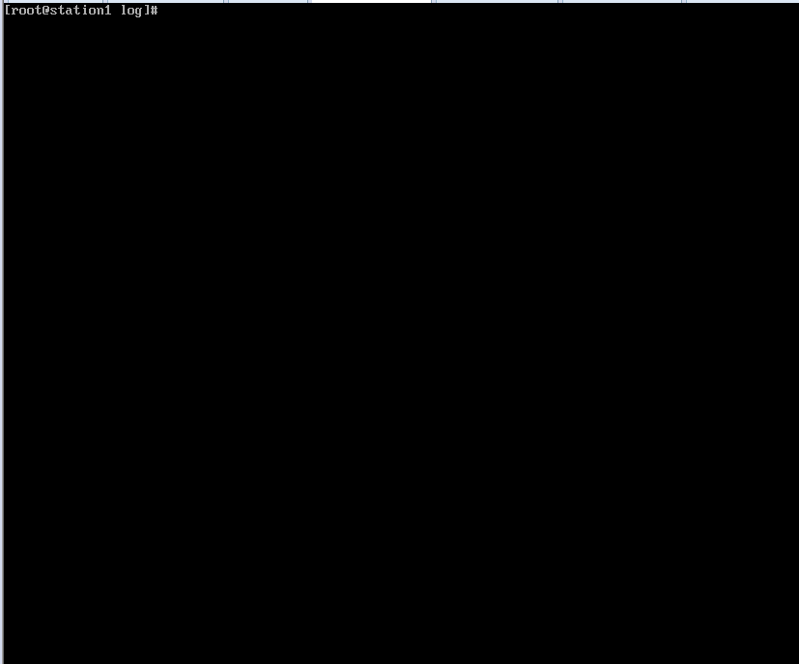
clear
clear = clear screen

Slide 14
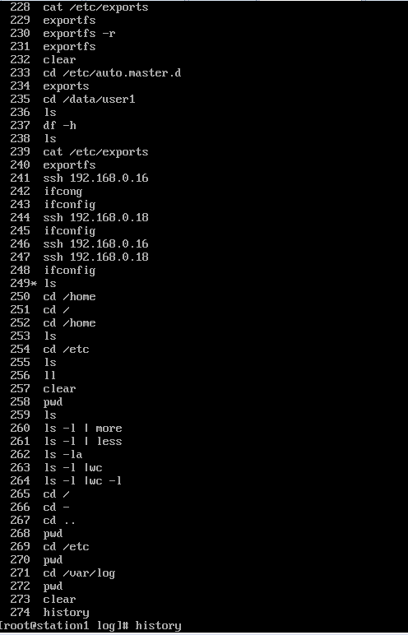
history
history = all the commands you run since it running

Slide 15
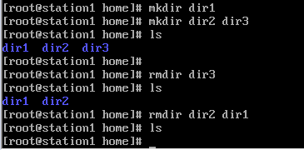
create the directory
mkdir (directory name) = create the directory
rmdir (directory name = remove directory
mkdir dir1 dir2 dir3 = multiple directory
rmdir dir1 dir2 dir3

Slide 16
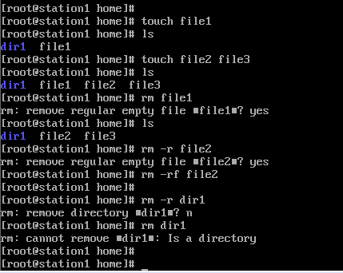
Create file
touch file1 = create file
touch file1 file2 file3 =create multiple files
rm file = delete the file
rm –r delete the file/directory
rm –rf force it .It will not ask for permission

Slide 17
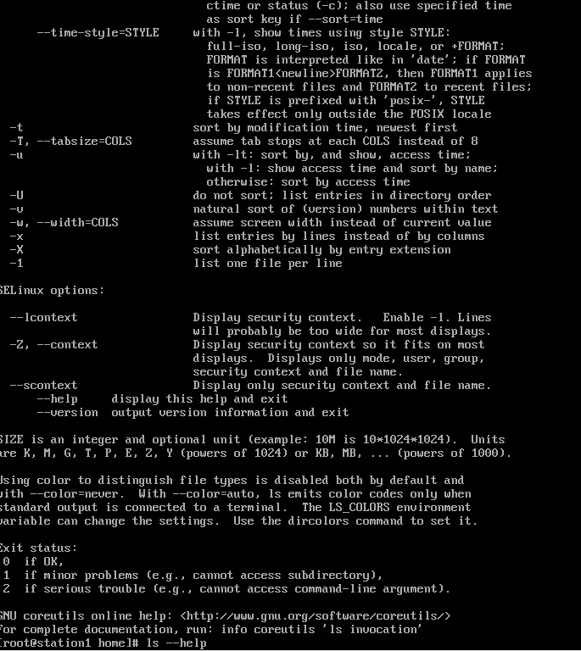
Command --help

Slide 18
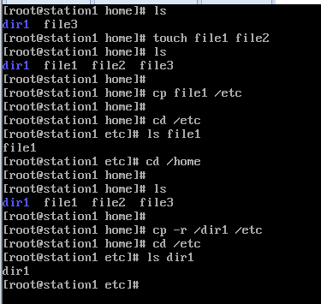

Copy
cp filename /directory1/directory2 = copy files
cp -r /directory /directory1/directory2
cp -r /directory . = it mean you copying to current folder

Slide 19
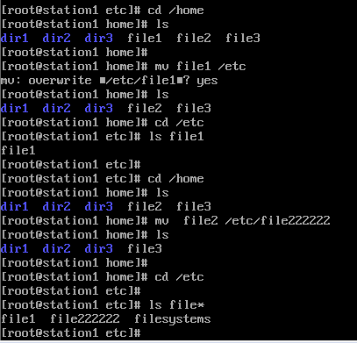
Move
mv file1 /directory = move
mv file1 file2 = rename

Slide 20
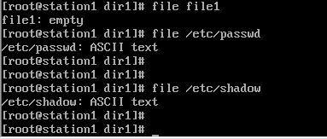
file
file filename or dest. = kind of file
file /etc/passwd

Slide 21
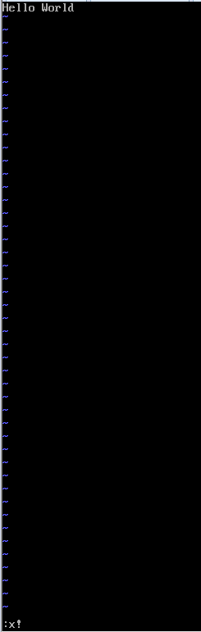
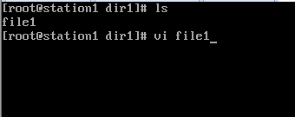
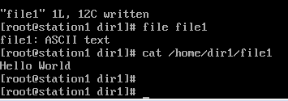

Vi editor
vi filename =text editor and also create new file
esc and I = let you insert text
esc and :q! = quit with out saving
esc and :x! = save on file
esc and o = go to the last line and insert
ctl + v = it take you visual mode then select text
using arrow keys and press y and then for paste p

Slide 22
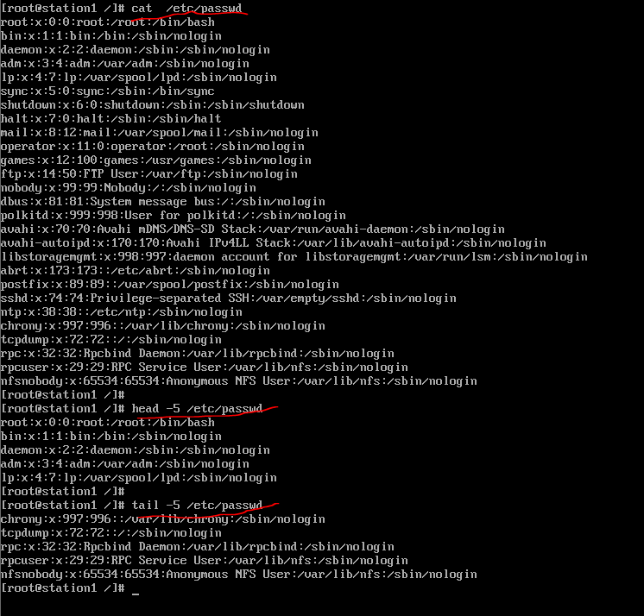
head
head -5 /etc/passwd
tail -5 /etc/passwd
ps and top

Slide 23
whoami
whoami - who you currently logged in as
which - tells the path where program is located

Slide 24

uptime
uptime

Slide 25
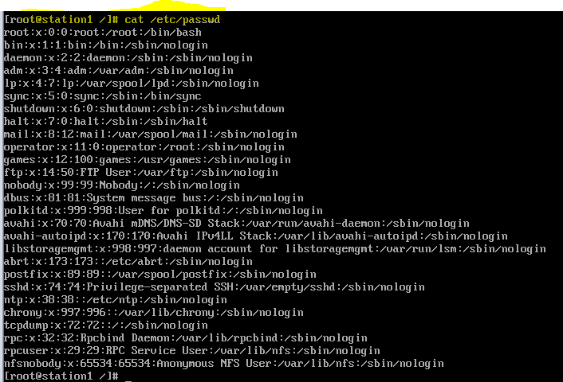
cat
cat /et/passwd

Slide 26
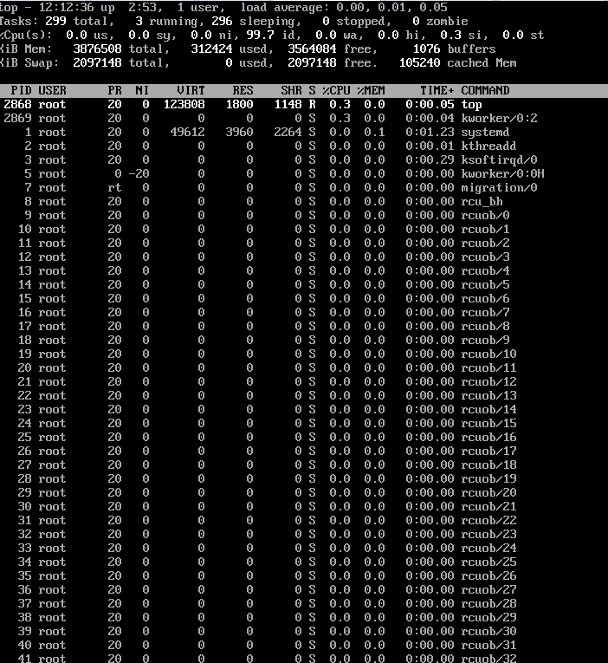
top

Slide 27
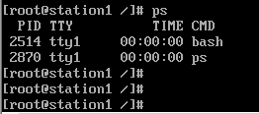
ps
ps - display process status information

Slide 28
Package Management

Slide 29
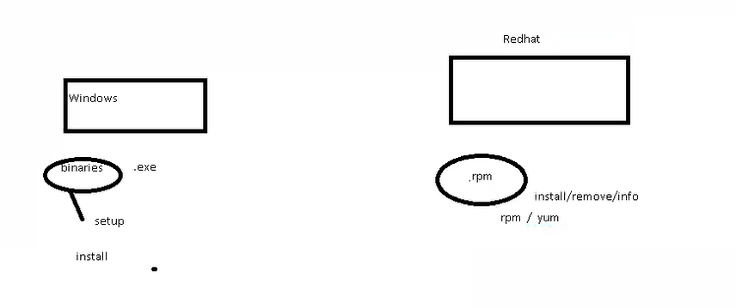

Slide 30
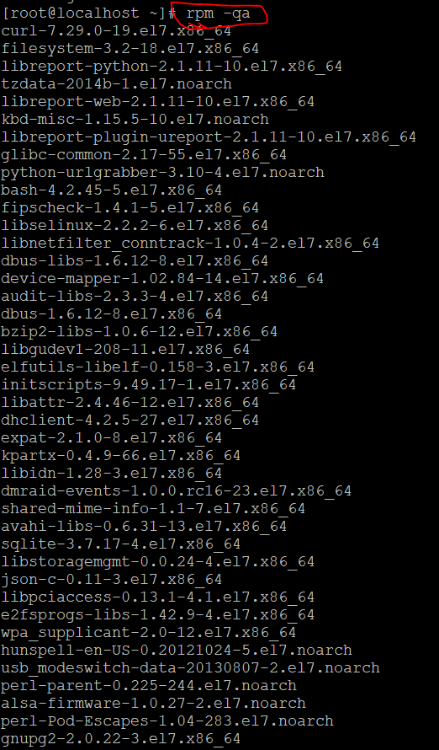
rpm
-q : query
a: all
The output shows the number of packages which are installed.

Slide 31

Rpm –qa | wc -l
I want to know the number of packages.
Instead of displaying the output of rpm –qa it will forward the output to wc (| for forward and wc :word count)
-l :lines
So in our machine we have 484 packages which are installed.

Slide 32
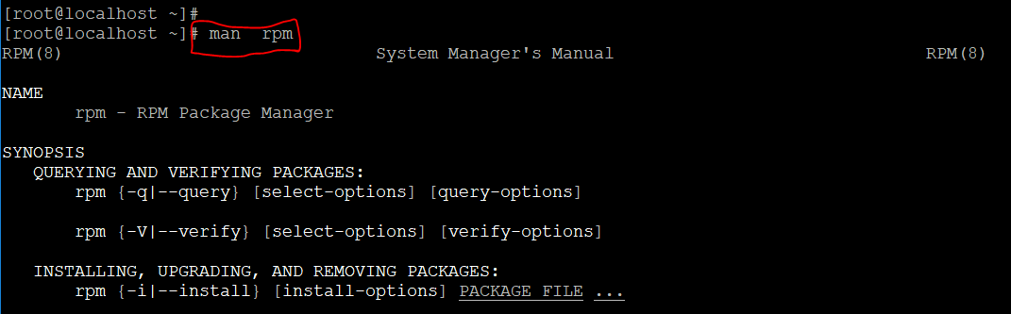
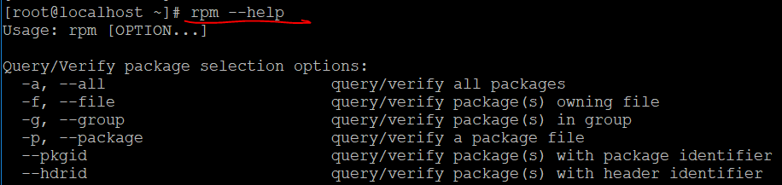
Help
Man can be used for help (its very detailed)
For quick help type rpm –help

Slide 33
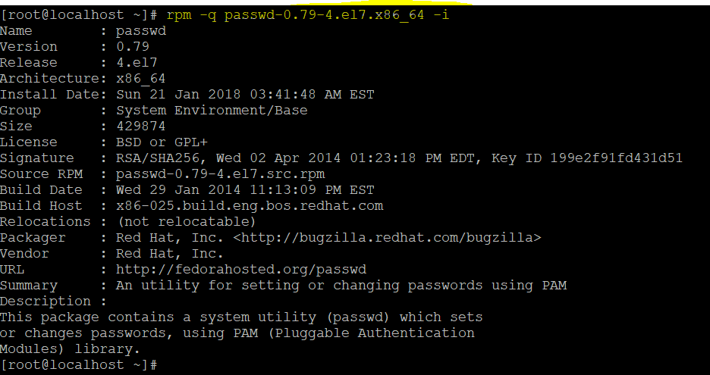
How to see information of a package
To get the information of the software

Slide 34
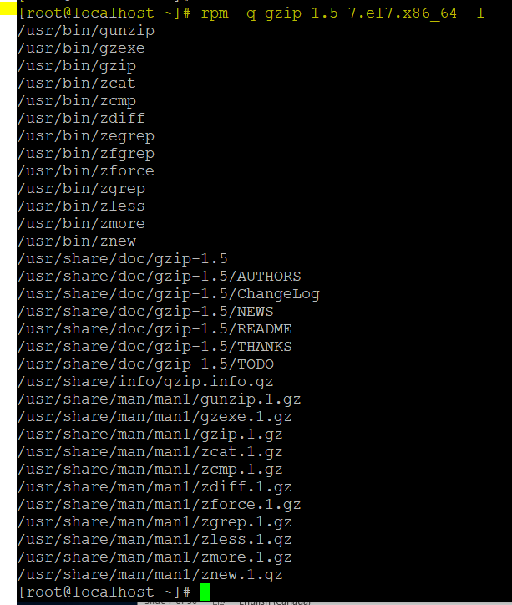
List of files which are installed by this package

Slide 35


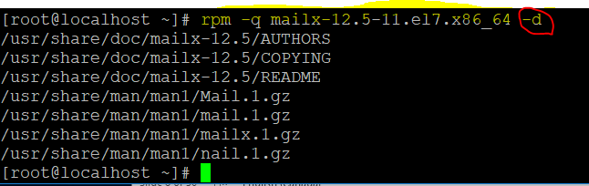
If you use –c it does not show any thing because it does not have a configuration file
d for documentation . Shows all the documents for this package

Slide 36
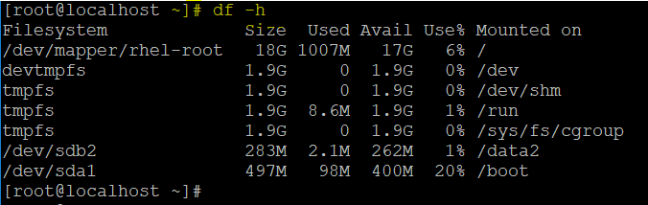
Df –h
Df –h will tell you all mounted file system

Slide 37
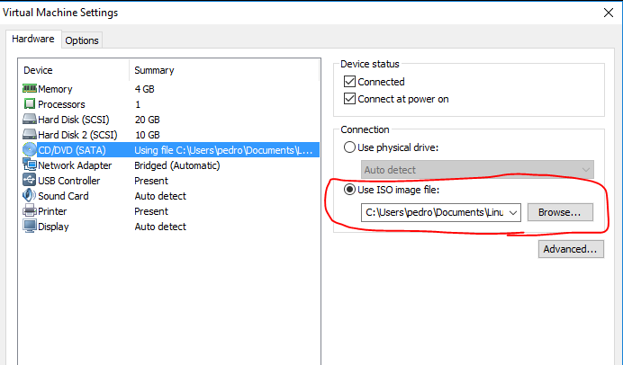

Attach dvd and mount
VM Ware –Setting –CD/DVD

Slide 38
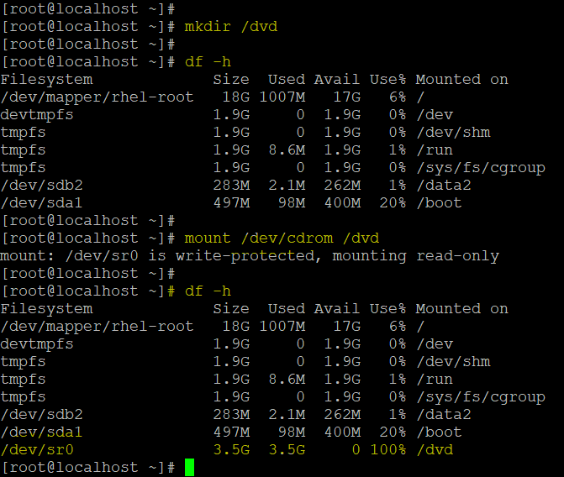
Before running mount command we can not see dvd in df –h
After mounting the dvd we can see it in df –h
Every time you reboot the system you need to mount it.

Slide 39
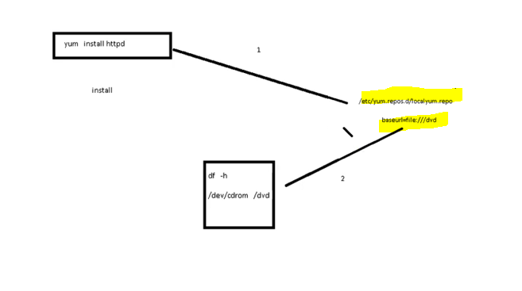
yum.repo
Whenever you want to install a packages you can use Yum however it will go to /etc/yum.repose.d/localyum.repo and see where the dvd is mounted
As you can see based on df –h it has been mounted to /dvd so you have entered baseurl= file:///dvd to point to the dvd (you can also point to the url)
Enable means you want to enable this directory
“Gpgcheck” means we do not need the license

Slide 40

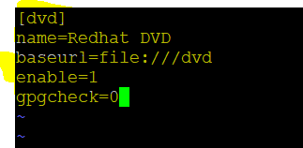

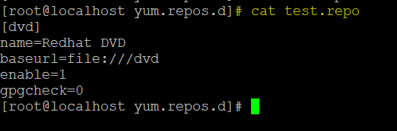
Yum will always check its directory so we need to create in /etc/yum.repos.d directory
You can use cat to see the content of the file
[dvd] : name (make sure the space does not have any name)
Make sure the extension of the file is repo

Slide 41
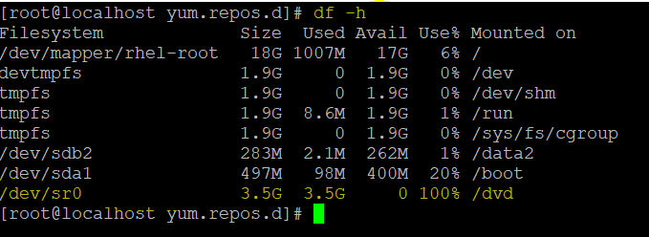
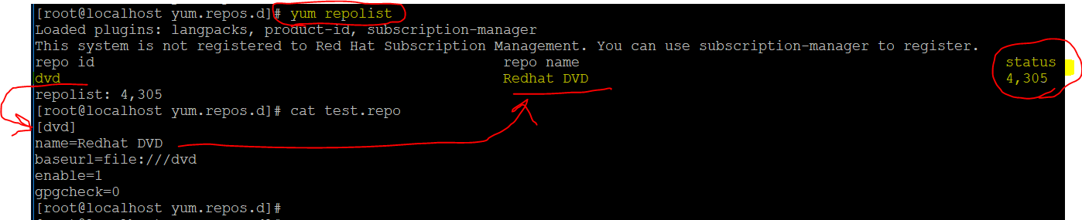
We should see /dvd by running the command df –h
How to check repos is working ???!!!!
If you have not point to the dvd properly you will see 0 instead of 4,305

Slide 42
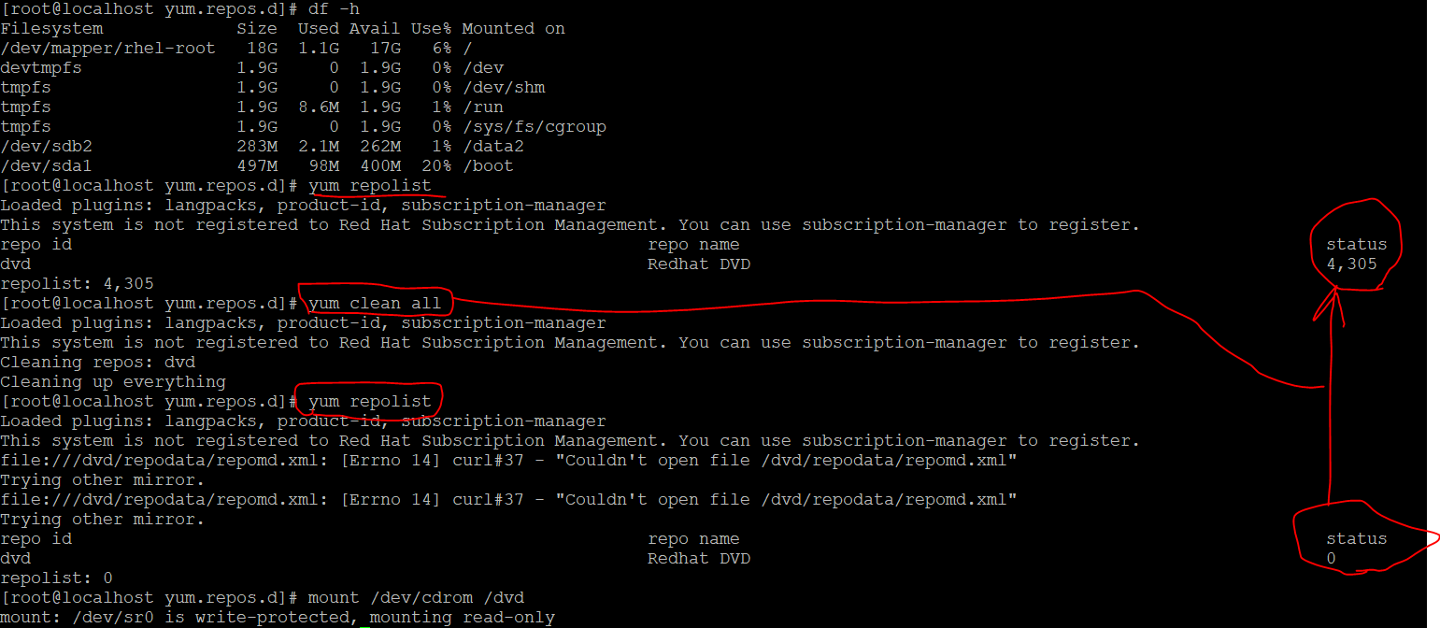
Yum clear all will clear the cash so after we mont we still see numbers on status so we need to clear the cash because it is showing the old one .

Slide 43
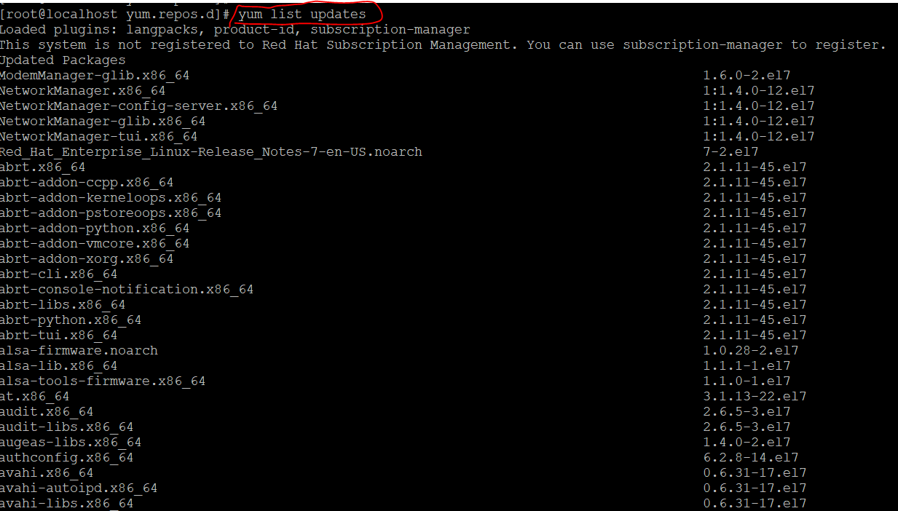

Slide 44
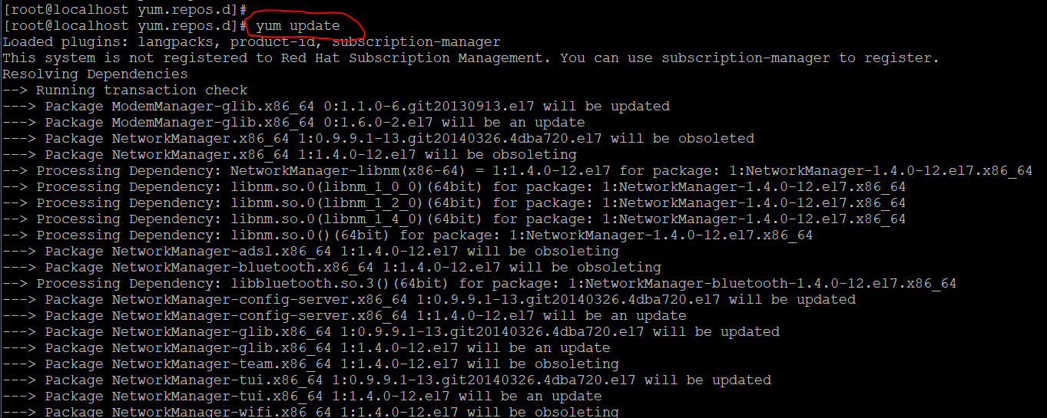
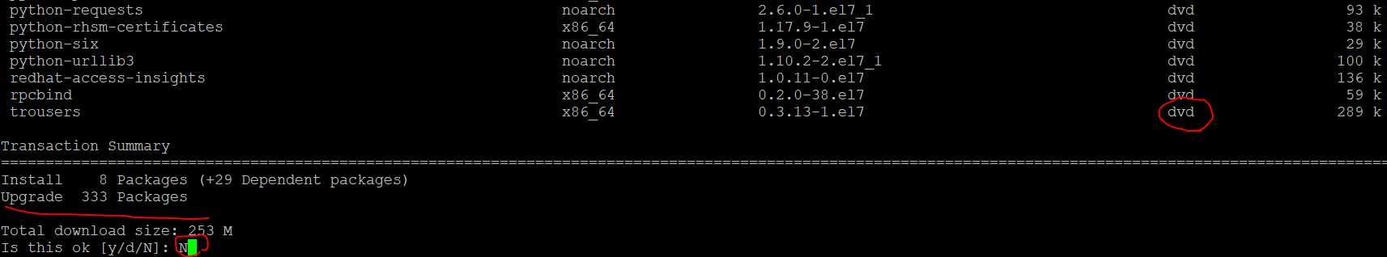
Yum update will list all packages but it will ask for permission to install .As you can see its from dvd .You can use yum update –y to not ask for permission

Slide 45
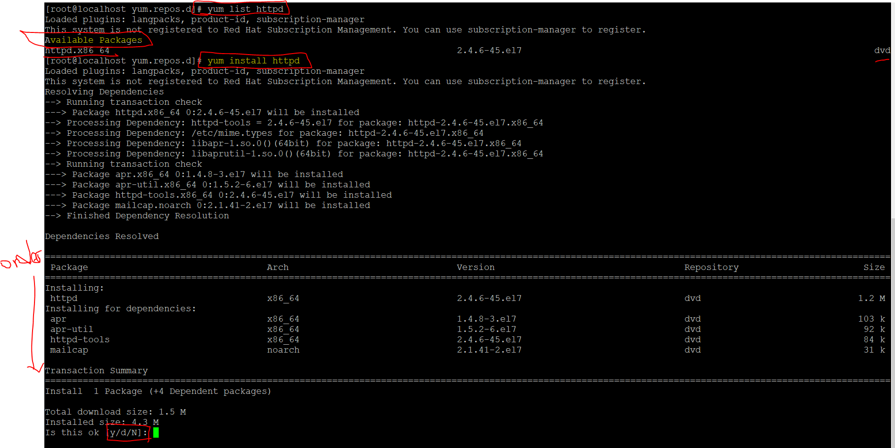

Slide 46
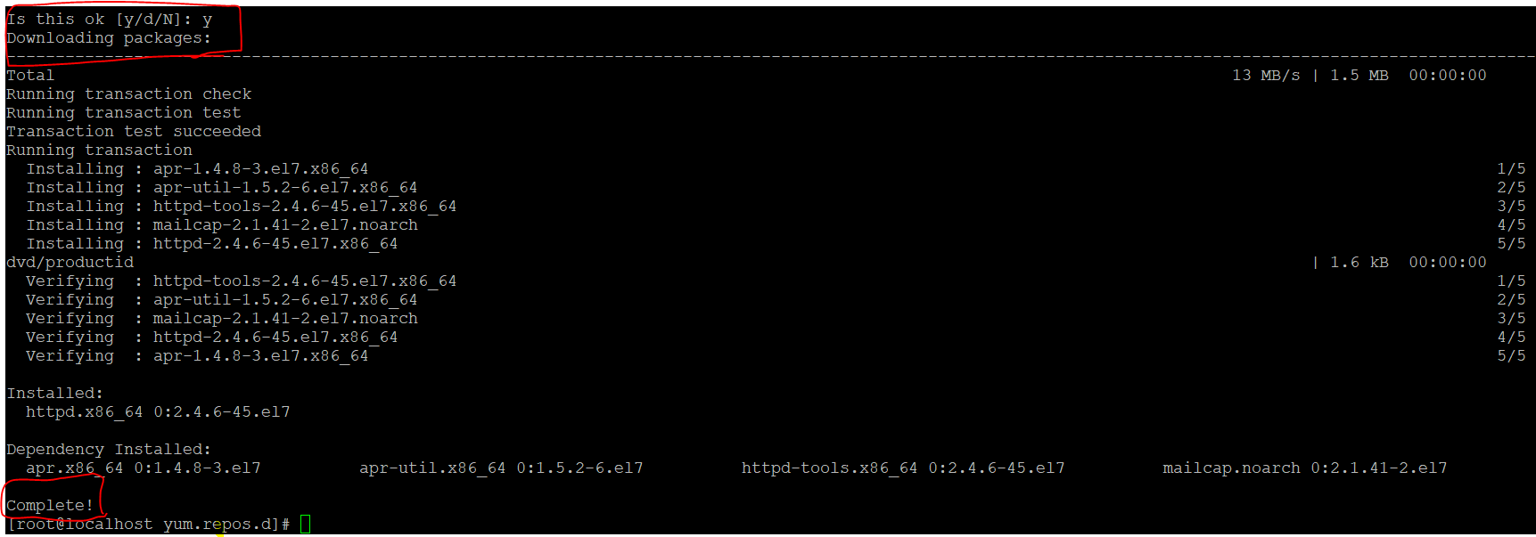

Slide 47
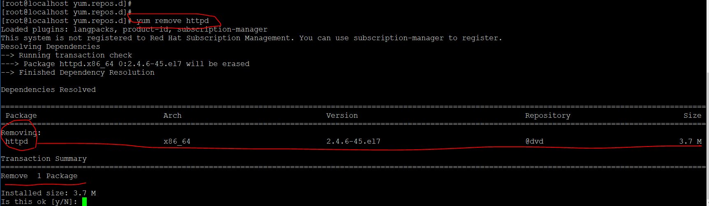
You can use yum remove httpd to remove the packages but as you can see it will only remove one package however we installed many packages for httpd .Why ???!!!

Slide 48
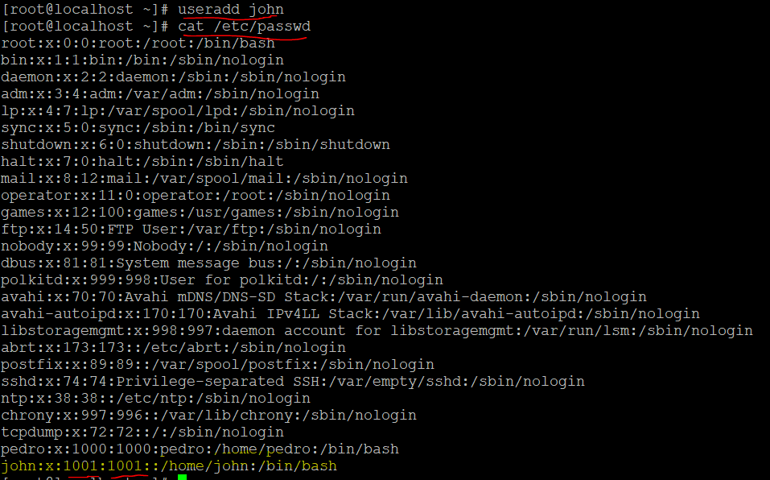
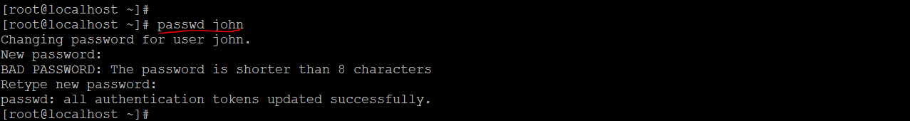
User/Password
We create user john

Slide 49
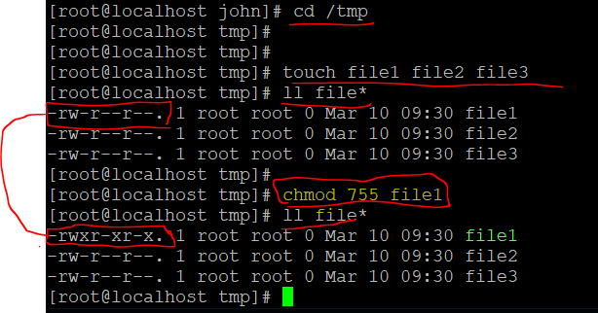

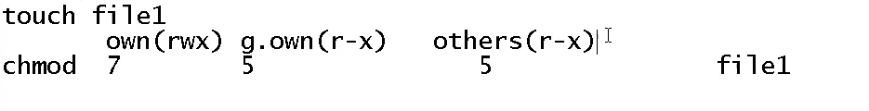
Permission
We change the permission of file 1

Slide 50
wget
tar
unzip

